Slide 1

2022
Year in Review

Slide 2
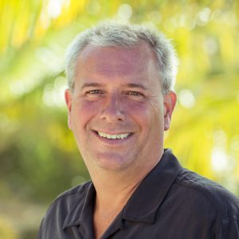
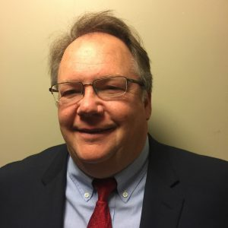
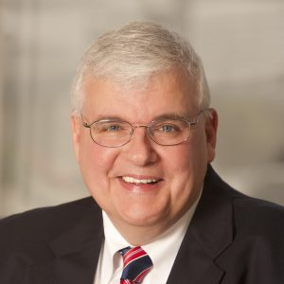
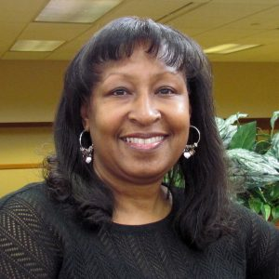
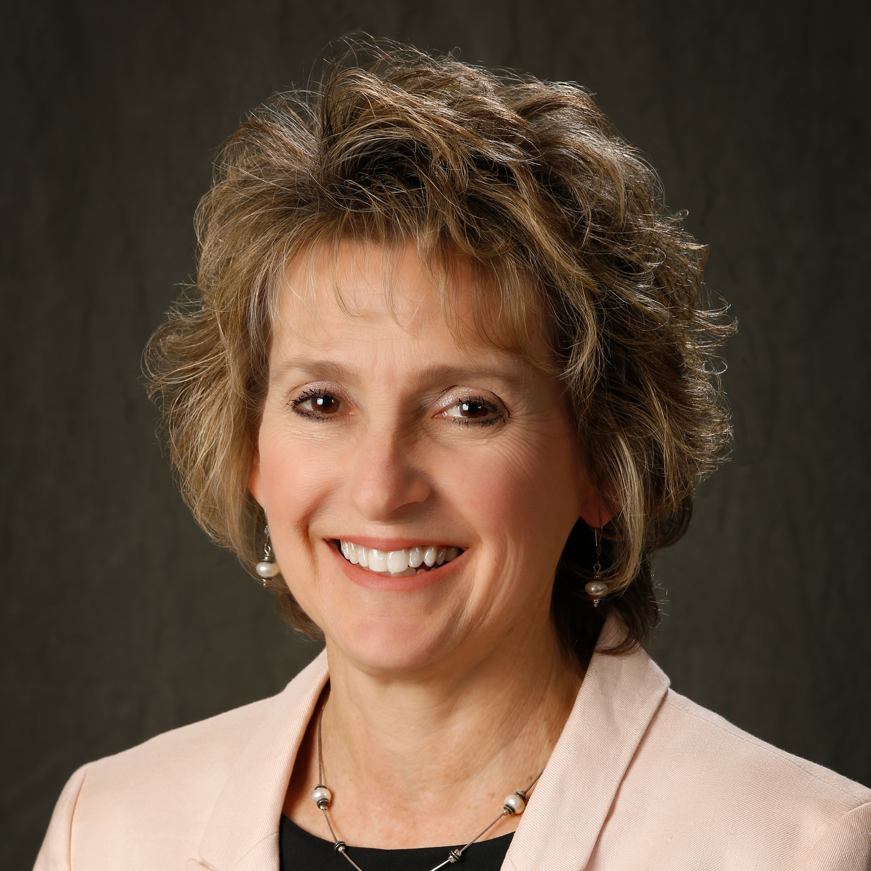
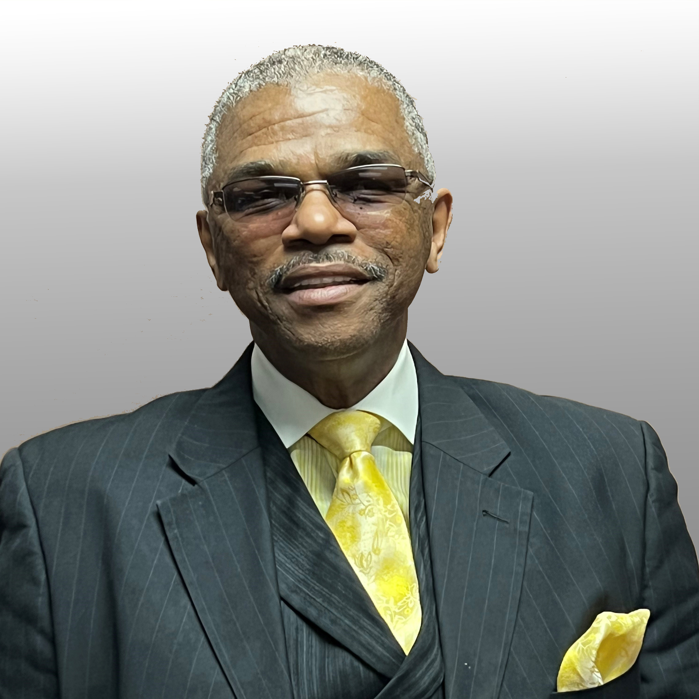
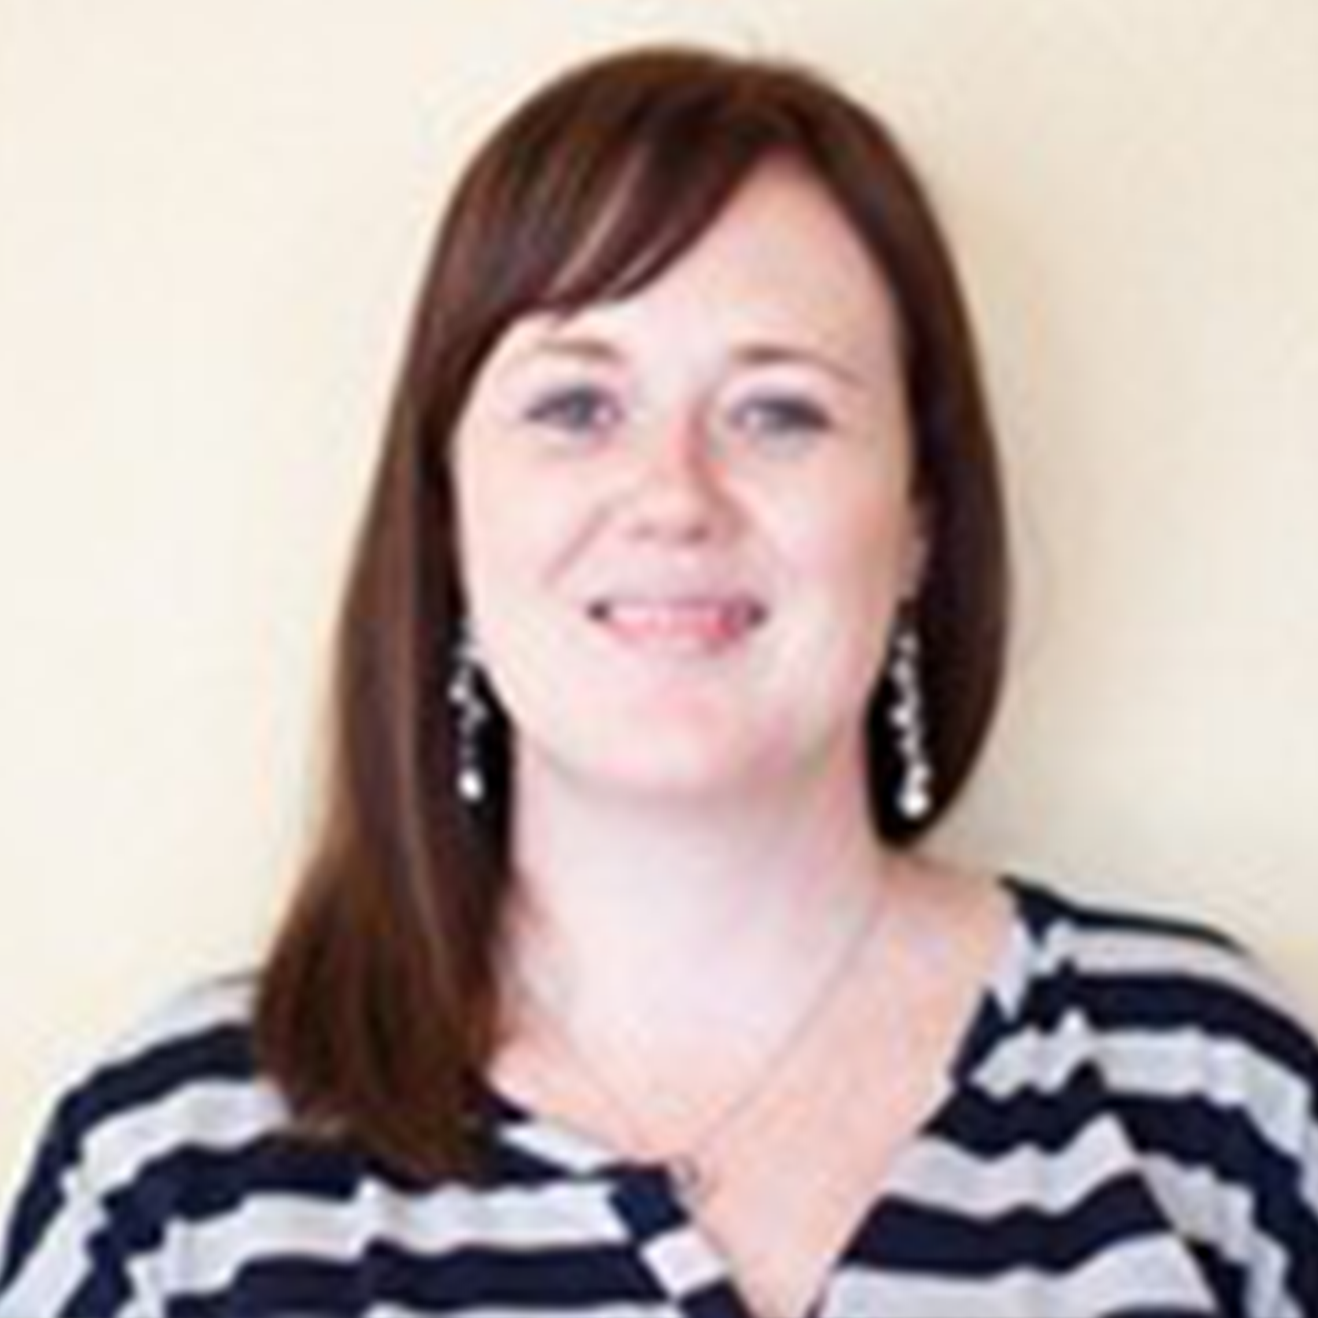
Our Board of Directors
Don Kiley Chairman
Mike Rogers
Vice Chairman
Allen Norris
Recording
Secretary
Amelia Law
Financial Secretary
Mary Ann
Kabel
Director
Tyrone McGuffey
Director
Jessica Osborne
Director

Slide 3
2022 Highlights
Shares grew over $14 million
Loans increased $17 million
Enhanced our Trail Blazer checking account
Implemented Pay Anyone and iCash Loan
Added rate bump feature to share certificates

Slide 4

Statements of Financial
Condition
ASSETS | 2022 | 2021
Cash & Cash Equivalents | $10,298,634 | $12,477,480
Investments | $13,507,187 | $13,877,857
Loans to Members & Loan Participations | $91,881,205 | $73,739,390
Property & Equipment | $1,273,991 | $1,334,916
Other Assets | $4,557,745 | 5,229,663
Total Assets | $121,518,762 | $106,659,306

Slide 5
Statements of Financial
Condition
LIABILITIES & MEMBERS’ EQUITY | 2022 | 2021
Members’ Share Accounts | $111,086,236 | $96,861,539
Notes Payable | $1,000,940 | -
Accrued Expenses & Other Liabilities | $854,034 | $770,040
Members’ Equity | $8,577,552 | $9,027,727
Total Liabilities & Members’ Equity | $121,518,762 | $106,659,306

Slide 6
Statements of Income
 | 2022 | 2021
Net Interest Income | $3,547,570 | $3,230,101
Non-Interest Income | $1,235,410 | $1,082,522
Non-Interest Expense | $4,170,173 | $3,729,774
Net Income | $612,807 | $582,849

Slide 7
Questions?
Questions may be submitted by email to ask@daymetcu.com.

